Slide 1
Turing-complete templates for everyone!
YAPC::EU 2014 София
Sophia.pm
Notes:
recruiting now (can't later)
last standing survivor of Sophia.pm (not a typo)
we're hiring!

Slide 2
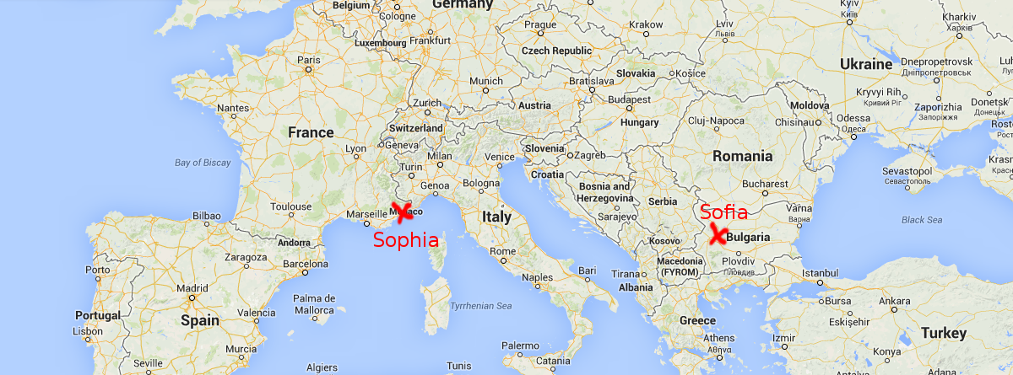
Sophia.pm
Notes:
not this, that
France, accent
Who already used Perl templating?
Who's going to attend Su-Shee's talk?

Slide 3
Templating in Perl
Template-Toolkit
Template::Alloy
Text::Xslate
HTML::Template
many others
Notes:
met in hallway
only reasonable thing to do: create a new one
Everybody knows what TC is?
Are those frameworks TC?

Slide 4
[% FOREACH page IN pages %]
* [% page.title %]
[% END %]
[% RAWPERL %]
$ouput .=
too_hard_just_call_perl();
[% END %]
Notes:
former Perl golfer
LONG identifiers
impure syntax

Slide 5
Idealism
hacks
quirks
kludges
This is 2014
Turing completeness is a requirement.
Must be a core part of the design

Slide 6
Design purity
< > [ ]
+ - , .
Urban Müller, 1993
Notes:
seminal research project
probably means: Awesome Contraption of Pure Computing Power
no comments

Slide 7
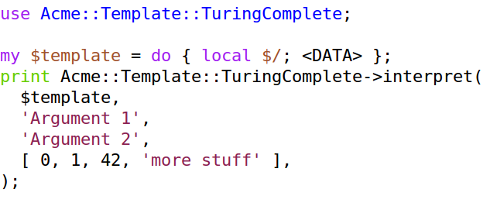
Show me the code
Notes:
Almost like we had a type system

Slide 8
Basic templates
Straight text
Straight text

Slide 9
Iteration
+++[
* repeated three times
-]
* repeated three times
* repeated three times
* repeated three times

Slide 10
Full-fledged character generation
++++++++++[>+++++++>++++++++++>+++>+++++++++<<<<-]
>++.>+.+++++++..+++.>++.>---.<<.+++.------.--------.>+.
Hello World!

Slide 11
Positional parameters
,>+++[<{.}>-]
'Badger'
{Badger}{Badger}{Badger}
Notes:
This one had a huge bug on stage.
So sue me.

Slide 12
Basic string manipulation
,[=.]=
'Iterating on a string'
=I=t=e=r=a=t=i=n=g= =o=n= =a= =s=t=r=i=n=g=

Slide 13
Native arrays
,[.]
[qw(Iterating on an array)]
Iteratingonanarray

Slide 14
Advanced string manipulation
,[[>>++++[>++++++++<-]<+<-[>+>+>-[>>>]<[[>+<-]>>+>]<<<<<-]]>>>[-]+>--[-[<->+++[-]]]<[++++++++++++<[>-[>+>>]>[+[<+>-]>+>>]<<<<<-]>>[<+>-]>[-[-<<[-]>>]<<[<<->>-]>>]<<[<<+>>-]]<[-]<.[-]<-]
'Qrpelcgvat n zvyvgnel-tenqr pvcure'
Decrypting a military-grade cipher

Slide 15
Closing words
it works
use it
not on CPAN (yet)
questions?

Slide 16
Credits
http://stackoverflow.com/q/14236318/12274
http://www.template-toolkit.org/docs/tutorial/Web.html
http://www.reddit.com/r/tinycode/comments/1oqgwm/shortest_hello_world_brainfuck_code/
https://en.wikipedia.org/wiki/Brainfuck#ROT13
http://codegolf.stackexchange.com/a/933/199
https://github.com/jmazon/Acme-Template-TuringComplete

